Slide 1
Chapter 9
How to use effects and animation

Slide 2
Objectives
Applied
Use jQuery to add effects and animations to a web page.
Knowledge
In general terms, describe the use of the jQuery methods for effects.
Describe how to stop and start a slide show that uses an interval timer.
In general terms, describe how the jQuery animate() method works.
Explain how the chaining effects and animations works and how callback functions can affect the results.
Describe the use of the delay(), stop(), and finish() methods with effects and animations.
Describe the use of easings with effects and animations.

Slide 3
The basic methods for jQuery effects
show()
hide()
toggle()
slideDown()
slideUp()
slideToggle()
fadeIn()
fadeOut()
fadeToggle()
fadeTo()

Slide 4
The basic syntax for all of the methods except the fadeTo() method
methodName([duration][, callback])
The basic syntax for the fadeTo() method
fadeTo(duration,opacity[, callback])

Slide 5
HTML for a heading that is animated after the web page is loaded
<h1 id="startup_message">Temporarily under construction!</h1>
jQuery that fades the heading out over 5 seconds
$("#startup_message").fadeOut(5000);
jQuery that uses chaining to fade the heading out and slide it back down
$("#startup_message").fadeOut(5000).slideDown(1000);
Chaining with fadeTo() methods
$("#startup_message").fadeTo(5000, .2).fadeTo(1000, 1);
jQuery with a callback function that gets the same result as the chaining
$("#startup_message").fadeTo(5000, .2,
evt => $(evt.currentTarget).fadeTo(
1000, 1) // callback function
);

Slide 6
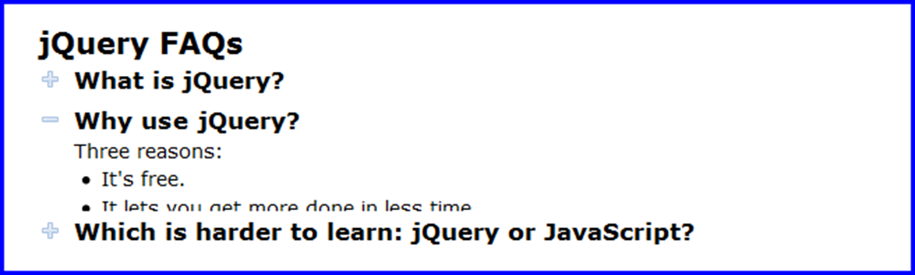
The FAQs application as the text for a heading is displayed

Slide 7
The HTML for the FAQs application
<main id="faqs">
<h1>jQuery FAQs</h1>
<h2><a href="#">What is jQuery?</a></h2>
<div><!-- div content --></div>
<h2><a href="#">Why use jQuery?</a></h2>
<div><!-- div content --></div>
<h2><a href="#">Which is harder to learn: jQuery or
JavaScript?</a>
<div><!-- div content --></div>
</main>

Slide 8
The JavaScript and jQuery with slideDown() and fadeOut() methods
"use strict";
$(document).ready( () => {
$("#faqs h2").click( evt => {
const target = evt.currentTarget;
$(target).toggleClass("minus");
if ($(target).attr("class") != "minus") {
$(target).next().fadeOut(1000);
}
else {
$(target).next().slideDown(1000);
}
});
});

Slide 9
The JavaScript and jQuery with the slideToggle() method
"use strict";
$(document).ready( () => {
$("#faqs h2").click( evt => {
$(evt.currentTarget).toggleClass("minus");
$(evt.currentTarget).next().slideToggle(1000);
});
});

Slide 10
Terms related to effects
effect
animation
callback function

Slide 11

The Slide Show application with fading out and fading in

Slide 12
The HTML for the Slide Show application
<main>
<h1>Fishing Slide Show</h1>
<h2 id="caption">Casting on the Upper Kings</h2>
<img id="slide" src="images/casting1.jpg" alt="">
<div id="slides">
<img src="images/casting1.jpg"
alt="Casting on the Upper Kings">
<img src="images/casting2.jpg"
alt="Casting on the Lower Kings">
<img src="images/catchrelease.jpg"
alt="Catch and Release on the Big Horn">
<img src="images/fish.jpg"
alt="Catching on the South Fork">
<img src="images/lures.jpg"
alt="The Lures for Catching">
</div>
</main>

Slide 13
The critical CSS for the Slide Show application
img {
height: 250px;
}
#slides img {
display: none;
}

Slide 14
One way to code the JavaScript and jQuery (part 1)
"use strict";
$(document).ready( () => {
// create an array of the slide images
let imageCache = [];
$("#slides img").each( (index, img) => {
const image = new Image();
image.src = $(img).attr("src");
image.title = $(img).attr("alt");
imageCache[index] = image;
});

Slide 15
One way to code the JavaScript and jQuery (part 2)
// start slide show
let imageCounter = 0;
setInterval( () => {
$("#caption").fadeOut(1000);
$("#slide").fadeOut(1000,
() => {
imageCounter = (imageCounter + 1) %
imageCache.length;
const nextImage = imageCache[imageCounter];
$("#slide").attr("src",
nextImage.src).fadeIn(1000);
$("#caption").text(nextImage.title).fadeIn(1000);
}); // end fadeOut() method
},
3000); // end setInterval() method
});

Slide 16
Another way to code the JavaScript and jQuery (part 1)
"use strict";
$(document).ready( () => {
let nextSlide = $("#slides img:first-child");
// start slide show
setInterval( () => {
$("#caption").fadeOut(1000);
$("#slide").fadeOut(1000,
() => {
if (nextSlide.next().length == 0) {
nextSlide =
$("#slides img:first-child");
}
else {
nextSlide = nextSlide.next();
}

Slide 17
Another way to code the JavaScript and jQuery (part 2)
const nextSlideSource =
nextSlide.attr("src");
const nextCaption =
nextSlide.attr("alt");
$("#slide").attr("src",
nextSlideSource).fadeIn(1000);
$("#caption").text(
nextCaption).fadeIn(1000);
}); // end fadeOut() method
},
3000); // end setInterval() method
});

Slide 18
The JavaScript and jQuery for stopping and restarting a slide show (part 1)
"use strict";
$(document).ready( () => {
let nextSlide = $("#slides img:first-child");
// the function for running the slide show
const runSlideShow = () => {
$("#caption").fadeOut(1000);
$("#slide").fadeOut(1000,
() => {
if (nextSlide.next().length == 0) {
nextSlide = $("#slides img:first-child");
} else {
nextSlide = nextSlide.next();
}
const nextSlideSource = nextSlide.attr("src");
const nextCaption = nextSlide.attr("alt");
$("#slide").attr("src",
nextSlideSource).fadeIn(1000);
$("#caption").text(nextCaption).fadeIn(1000);
}
); // end fadeOut() method
}; // end runSlideShow() arrow function

Slide 19
The JavaScript and jQuery for stopping and restarting a slide show (part 2)
// start slide show
let timer1 = setInterval(runSlideShow, 3000);
// starting and stopping the slide show
$("#slide").click( () => {
if (timer1 != null) {
clearInterval(timer1); // stop
timer1 = null;
}
else {
runSlideShow(); // start immediately
// change every 3 seconds
timer1 = setInterval(runSlideShow, 3000);
}
});
});

Slide 20
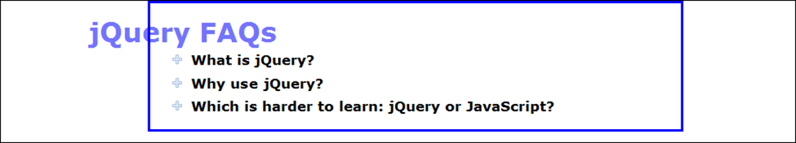
The basic syntax for the animate() method
animate({properties}[, duration][, callback])
An animated heading that is moving into the “faqs” section
The CSS for the h1 heading
#faqs h1 {
position: relative;
left: -175px;
font-size: 75%;
opacity: .2;
}

Slide 21
An animate() method for the h1 heading
Without a callback function
$("#faqs h1").animate(
{ fontSize: "275%", opacity: 1, left: 0 },
2000
);
With a callback function
$("#faqs h1").animate(
{ fontSize: "275%", opacity: 1, left: "+=175" },
2000,
() => $("#faqs h2").next().fadeIn(1000).fadeOut(1000)
);

Slide 22
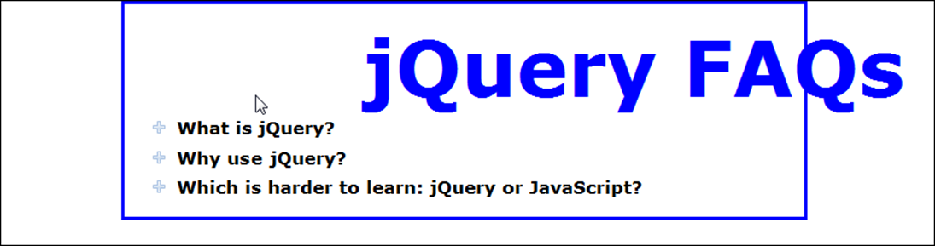
A heading with two animations started by its click event

Slide 23
Chained animations
$("#faqs h1").click( evt => {
$(evt.currentTarget)
.animate({ fontSize: "650%", opacity: 1,
left: "+=275" }, 2000)
.animate({ fontSize: "175%",
left: "-=275" }, 1000);
});

Slide 24
Queued animations
$("#faqs h1").click( evt => {
$(evt.currentTarget).animate(
{ fontSize: "650%", opacity: 1,
left: "+=275" }, 2000);
$(evt.currentTarget).animate(
{ fontSize: "175%", left: "-=275" }, 1000);
});

Slide 25
An animation with a second animation in its callback function
$("#faqs h1").click( evt => {
$(evt.currentTarget).animate(
{ fontSize: "650%", opacity: 1, left: "+=275" },
2000,
() => {
$(evt.currentTarget).animate(
{ fontSize: "175%", left: "-=275" }, 1000
);
} // end callback
);
});

Slide 26
The delay(), stop(), and finish() methods
Method Description
delay(duration) Delay the start of the next animation in the queue.
stop([clearQueue] Stop the current animation for the selected [,jumpToEnd]) element. The two parameters are Boolean with false default values. If set to true, the first parameter clears the queue so no additional animations are run. The second parameter causes the current animation to be completed immediately.
finish() Stop the current animation for the selected element, clear the queue, and complete all animations for the selected elements.

Slide 27
HTML for a heading that is displayed when the web page is loaded
<h1 id="startup_message">Temporarily under construction!
</h1>
jQuery that fades the heading out after 5 seconds
$("#startup_message").delay(5000).fadeOut(1000);

Slide 28
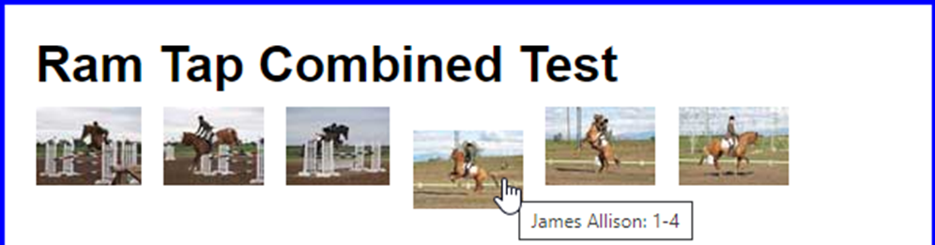
An animation that moves thumbnail images down on mouse hover
The HTML for the thumbnail images
<ul id="image_list">
<li><a href="images/h1.jpg" title="James Allison: 1-1">
<img src="thumbnails/t1.jpg" alt=""></a></li>
// four more li elements that contain thumbnail images
<li><a href="images/h6.jpg" title="James Allison: 1-6">
<img src="thumbnails/t6.jpg" alt=""></a></li>
</ul>
The CSS for the <a> elements
a { position: relative; }

Slide 29
The jQuery that stops the bouncing effect
$("#image_list a").hover(
evt => $(evt.currentTarget).stop(true).animate(
{ top: 15 }, "fast"),
evt => $(evt.currentTarget).stop(true).animate(
{ top: 0 }, "fast")
);

Slide 30
A script element for getting the jQuery easing plugin from a CDN
<script src="https://code.jquery.com/jquery-3.4.1.min.js">
</script>
<script src="https://cdnjs.cloudflare.com/ajax/libs/
jquery-easing/1.3/jquery.easing.min.js"></script>

Slide 31
The syntax for using easing with effects and animations
The syntax for all of the basic methods except fadeTo()
methodName([duration][, easing][, callback])
The syntax for the fadeTo() method
fadeTo(duration, opacity[, easing][, callback])
The syntax for the basic animate() method
animate({properties}[, duration][, easing][, callback])

Slide 32
Two easings used by the FAQs application
$("#faqs h2").click( evt => {
const target = evt.currentTarget;
$(target).toggleClass("minus");
if ($(target).attr("class") == "minus") {
$(target).next().slideDown(
1000, "easeOutBounce");
}
else {
$(target).next().slideUp(
1000, "easeInBounce");
}
});

Slide 33
Two easings for an animated heading
$("#faqs h1").click( evt => {
$(evt.currentTarget)
.animate({ fontSize: "650%", opacity: 1,
left: "+=275" },
2000, "easeInExpo")
.animate({ fontSize: "175%", left: "-=275" },
1000, "easeOutExpo");
});

Slide 34
A URL for a full list of jQuery easings
http://gsgd.co.uk/sandbox/jquery/easing

Slide 35
The advanced syntax for the animate() method
animate({properties}, {options})
Some of the options for the advanced syntax
duration
easing
complete
step
queue
specialEasing

Slide 36
An animate() method with the advanced syntax
$("#faqs h1").animate(
{ fontSize: "650%", opacity: 1, left: "+=175" },
{ duration: 2000,
specialEasing: { fontSize: "easeInExpo",
left: "easeOutExpo" },
complete: () =>
$("#faqs h2").next().fadeIn(1000).fadeOut(1000)
}
);

Slide 37
How to provide easings by property with the basic syntax
$("#faqs h1").animate(
{ fontSize: ["650%", "easeInExpo"],
opacity: [1, "swing"],
left: ["+=275", "easeOutExpo"] }, 2000
);

Slide 38
The methods for working with animation queues
Method Description
queue([name]) Get the queue for the selected element.
queue([name],newQueue) Replace the queue for the selected element with a new queue.
queue([name],callback) Add a new function (callback) to the end of the queue for the selected element.
dequeue([name]) Run the next item in the queue for the selected element.
clearQueue([name]) Remove all items that haven’t yet been run from the queue.

Slide 39
Terms related to animation
properties map
queue
easing

Slide 40
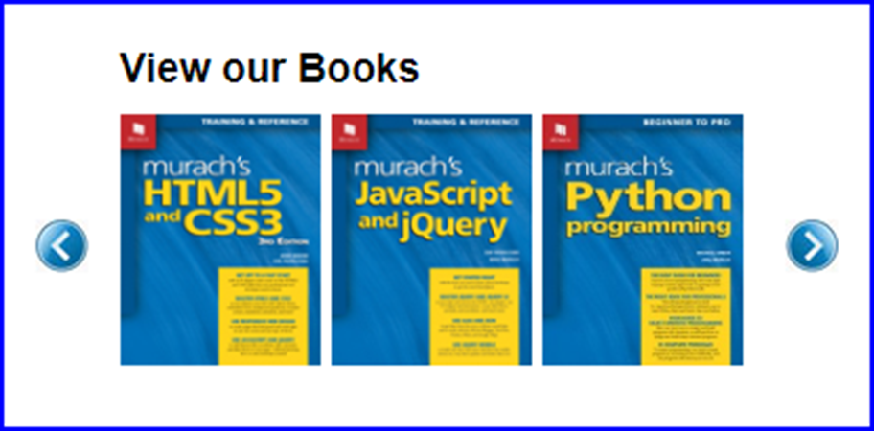
The Carousel application

Slide 41
The HTML for the Carousel application
<main>
<h1>View our Books</h1>
<div id="carousel">
<div id="left_button" class="button_panel">
<img src="images/left.jpg" alt=""></div>
<div id="display_panel">
<ul id="image_list">
<li><a href="newpage.html">
<img src="images/book1.jpg" alt="">
</a></li>
<li><a href="newpage.html">
<img src="images/book2.jpg" alt="">
</a></li>
// 7 more li elements that contain images
</ul>
</div>
<div id="right_button" class="button_panel">
<img src="images/right.jpg" alt=""></div>
</div>
</main>

Slide 42
The critical CSS for the Carousel application
#display_panel {
width: 300px;
overflow: hidden;
float: left;
height: 125px;
}
#image_list {
position: relative;
left: 0px; // required for IE
width: 900px;
list-style: none;
}
#image_list li {
float: left;
width: 100px;
}
#image_list li img {
width: 95px;
}

Slide 43
The JavaScript and jQuery for the Carousel application (part 1)
"use strict";
$(document).ready( () => {
const slider = $("#image_list"); // slider = ul element
// the click event handler for the right button
$("#right_button").click( () => {
// get value of current left property
const leftProperty = parseInt(slider.css("left"));
// determine new value of left property
let newLeftProperty = 0;
if (leftProperty - 300 > -900) {
newLeftProperty = leftProperty - 300;
}
// use the animate function to change the left property
slider.animate({left: newLeftProperty}, 1000);
});

Slide 44
The JavaScript and jQuery for the Carousel application (part 2)
// the click event handler for the left button
$("#left_button").click( () => {
// get value of current left property
const leftProperty = parseInt(slider.css("left"));
// determine new value of left property
let newLeftProperty = 0;
if (leftProperty < 0) {
newLeftProperty = leftProperty + 300;
}
// use the animate function to change the left property
slider.animate({left: newLeftProperty}, 1000);
});
});

